Slide 1
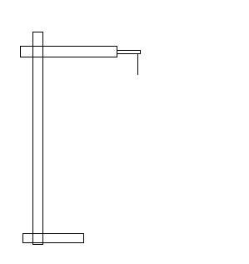
Meter rule
Retort stand
pointer
Slotted weight
Spiral spring

